Slide 1
19CSE211 Computer Architecture & Organization
Multi Cycle Data Path Implementation of MIPS Architecture-Part 1

Slide 2
Performance Analysis

Slide 3
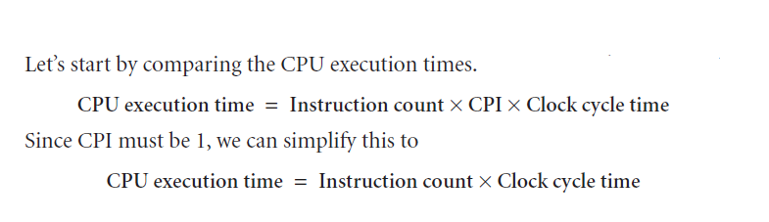
Problem Solution

Slide 4

Solution….

Slide 5
Performance Analysis

Slide 6
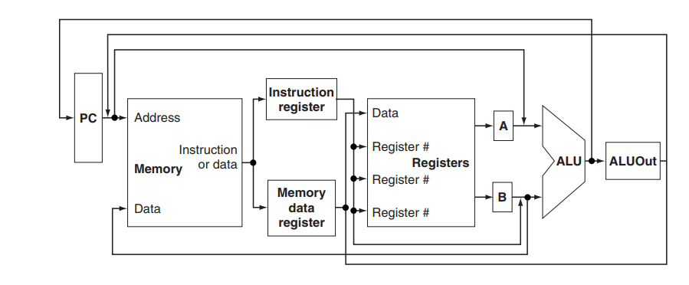
Abstract View of Multicycle Implementation

